Slide 1

FINITE SETS, COUNTING PRINCIPLE
Sets can be finite or infinite.
A set S is said to be finite if S is empty or if S contains exactly m elements where m is a positive integer;
otherwise S is infinite.

Slide 2




Slide 3


Slide 4
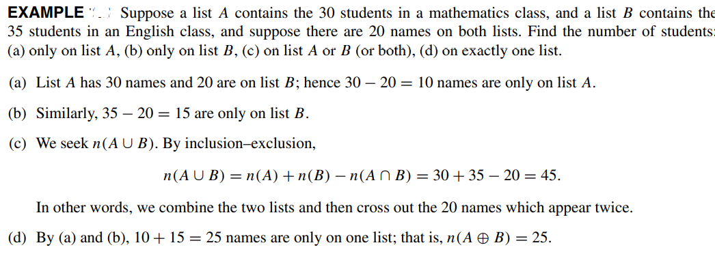

Slide 5


Power Sets
For a given set S , we may speak of the class of all subsets of S. This class is called the power set of S , and will be denoted by P(S). If S is finite, then so is P(S). In fact, the number of elements in P(S) is 2 raised to the power n(S). That is,

Slide 6


Slide 7



MATHEMATICAL INDUCTION

Slide 8




EXAMPLE Show that if n is a positive integer, then

Slide 9
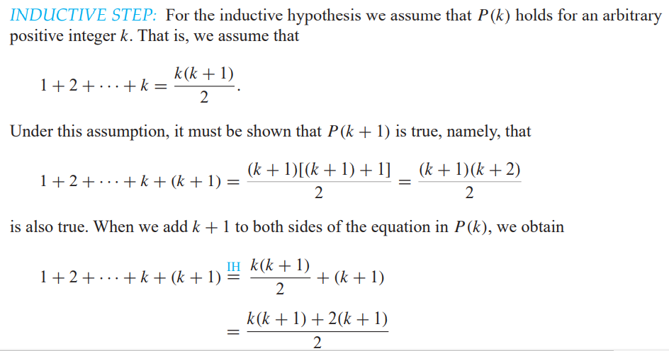


Slide 10

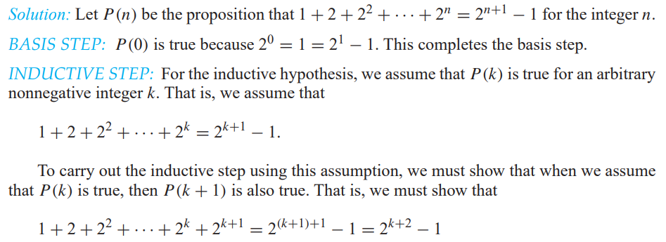

Slide 11


Slide 12



Slide 13
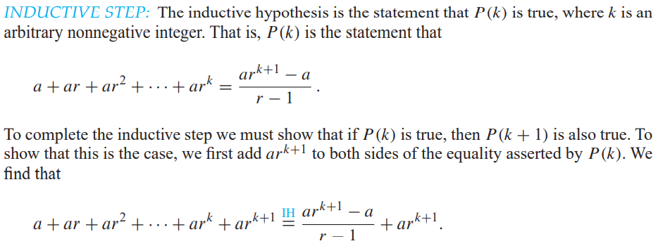

Slide 14
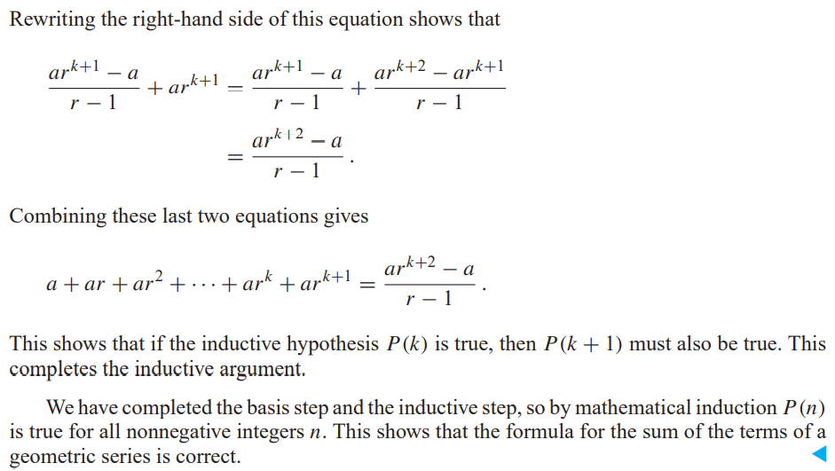

Slide 15



Slide 16


Slide 17
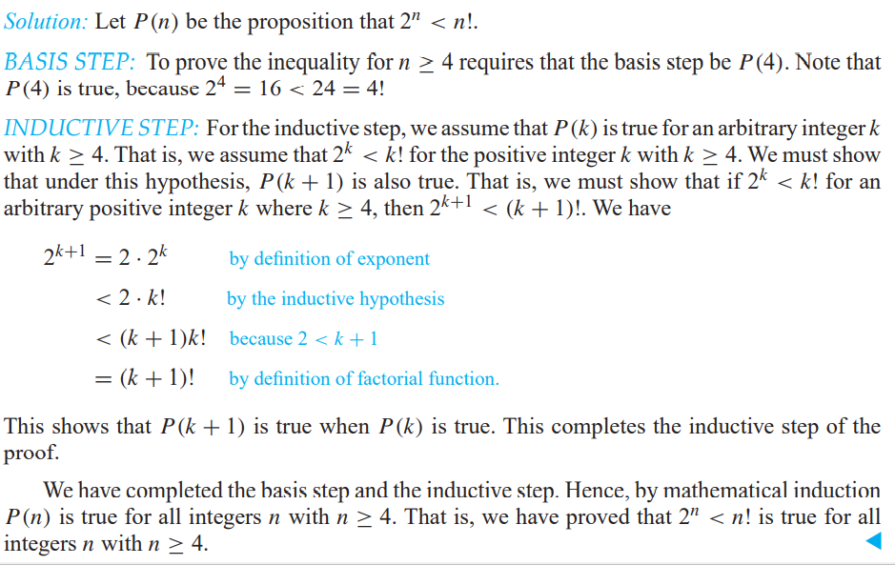

Slide 18

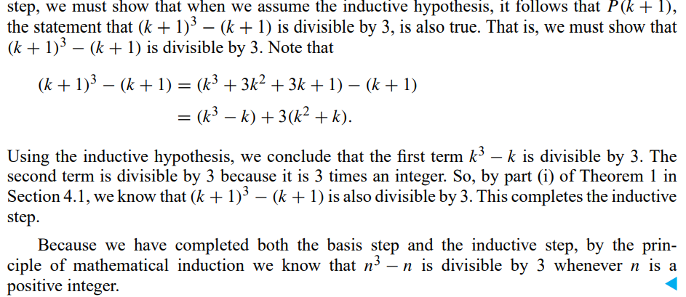

Slide 19
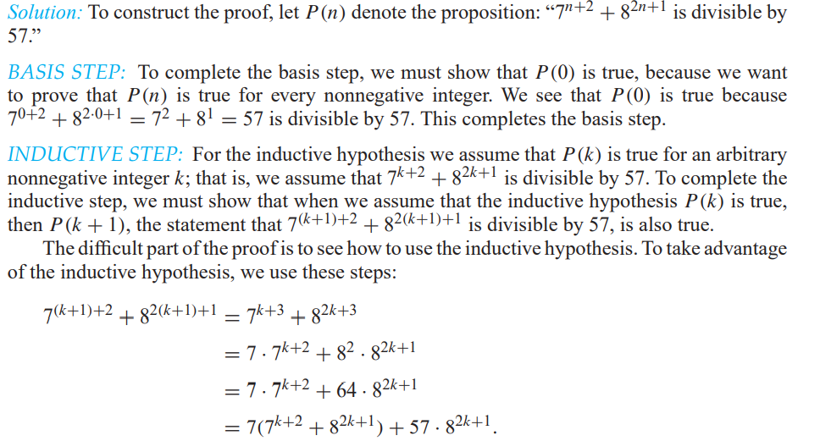

Slide 20


Slide 21
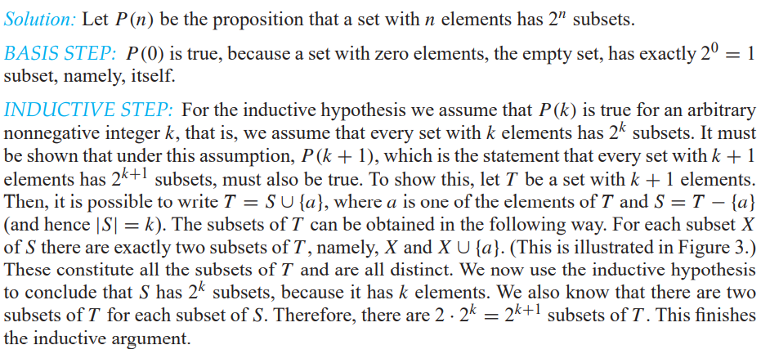

Slide 22


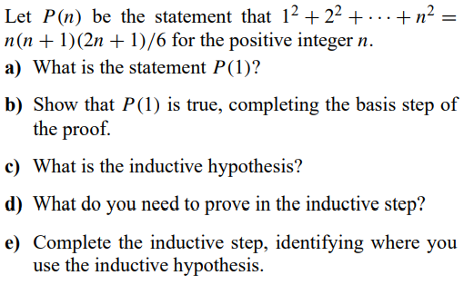


Slide 23

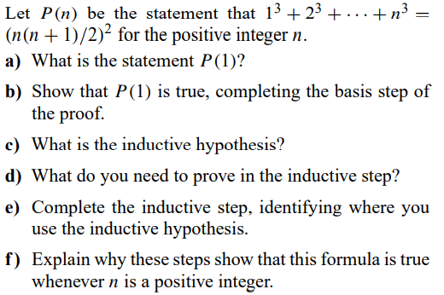

Slide 24


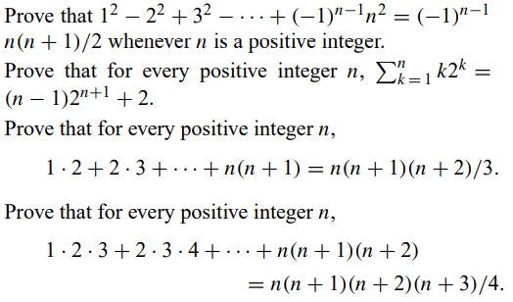

Slide 25




Slide 26


